Slide 1

Township of Bonfield 2025
Budget
June 24, 2025

Slide 2
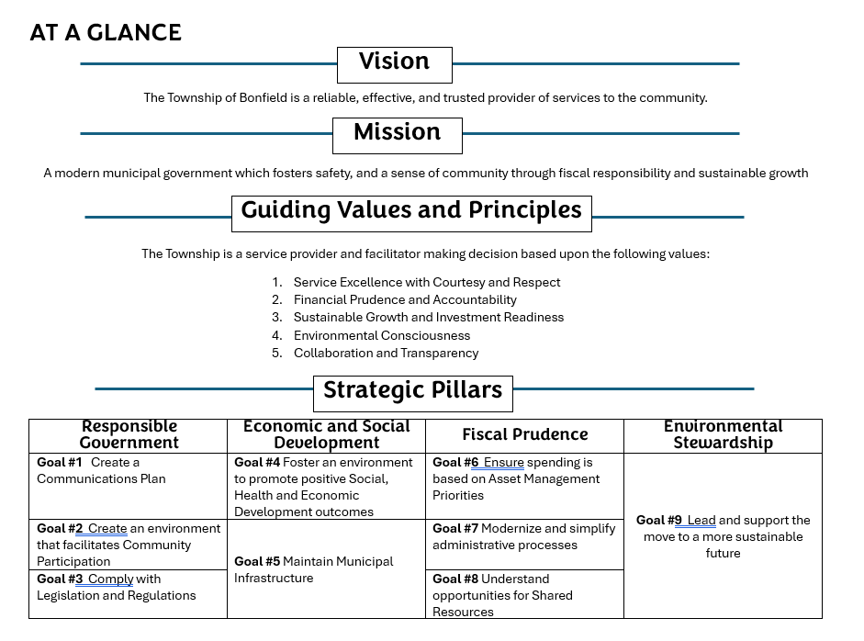
Bonfield Strategic Plan
This term of Council has focused on updating policies and procedures, finding efficiencies in operations and
roads, roads, roads!
The Strategic Plan adopted in March 2025 sets the stage to begin new direction and growth for the community.

Slide 3
Capital Budget 2025
Townsuite Financial Software $45,000 from Modernization Reserve Fund
Sweeper attachment $19,500 One time Rebate
Equipment Float $20,000 One time Rebate and $13,500 in operating
Trunk Road Bridge Replacement $450,000 New debt and $200,000 CCBF
Pine Lake Road (entrance) $ 60,550 OCIF
2 kms Development (west) $121,000 OCIF
Total Capital $720,500
In Levy $ 13,500 remainder deferred revenues

Slide 4
Projects 2025
Gravel Program: Municipal portion of Shields Point Road
Boxwell Road from Farmers line.
Grants: Fire Department bunker gear and emergency services radios (Fire and PW)
Implementing new planning and licencing bylaws, continue Official Plan and Zoning Update
New Website and communications plan – website live June 26! Please be patient
Asset Management Plan, Investment Policies and update reserves and debt policies
Continue reserve investments for Fire SCBA, expanding services at the Medical Centre and park
equipment

Slide 5
Operating Budget
General Government
 | 2022 | 2023 | 2024 | 2025
 | Actual | Budget | Budget | Budget
General Government
Suppls/PILs | 48,856 | 35,000 | 40,500 | 45,000
Financial Revenues | 137,874 | 138,840 | 113,600 | 123,850
Grants and Revenues | 668,301 | 691,300 | 691,300 | 779,200
Transfers from Reserves | 79,968 | 75,000 | 65,000 | 30,000
 | 934,999 | 940,140 | 910,400 | 978,050
Expenses | 874,259 | 1,058,275 | 1,167,501 | 1,071,575
MPAC Levy | 42,908 | 43,000 | 43,372 | 44,687
General Net Costs | - 17,832 | 161,135 | 300,473 | 138,212
Expenses include:
Council remuneration / training
Administration Costs
Legal/Audit/Insurance/ IT / IC
MPAC Levy

Slide 6
Operating Budget
Emergency Services
 | 2022 | 2023 | 2024 | 2025
Fire | Actual | Budget | Budget | Budget
Revenues | 16,100 | 11,100 | 13,600 | 29,898
Expenses | 191,943 | 235,570 | 251,936 | 348,585
Net Costs | 175,843 | 224,470 | 238,336 | 318,687
Emergency Management
Revenues | 0.00 | 0.00 | 0.00 | 45,006
Expenses | $21,745 | 44,080 | 44,720 | 79,325
Net Costs | 21,745 | 44,080 | 44,720 | 34,319
Expenses include:
Administration (insurance, IT, licensing, office)
Buildings (STN 1&2, heat, hydro, alarm, mtnce)
Fleet (9 vehicles)
2 grants; bunker gear & radios

Slide 7
Operating Budget
Building
Bylaw Enforcement
 | 2022 | 2023 | 2024 | 2025
 | Actual | Budget | Budget | Budget
Building
Revenues | 62,828.00 | 51,200.00 | 58,000.00 | 60,000
Expenses | 98,028.00 | 128,350.00 | 121,695.00 | 99,100
Net Costs | 35,200.00 | 77,150.00 | 63,695.00 | 39,100
Bylaw Enforcement Animal
Revenues | 0 | 0 | 500 | 500
Expenses | $14,203 | 14500 | 14575 | 9157
Net Costs | $14,203 | $14,500 | $14,075 | $8,657
Expenses include:

Slide 8
Operating Budget
Policing
 | 2022 | 2023 | 2024 | 2025
Policing | Actual | Budget | Budget | Budget
Revenues | 7836 | 8200 | 7500 | 7500
Expenses | $326,289 | 335,090 | 349,354 | 389,538
Net Costs | $318,453 | $326,890 | $341,854 | $382,038
Expenses include:
RIDE programs
Services of OPP
Lake Nosbonsing PSB

Slide 9
Operating Budget
Public Works
 | 2022 | 2023 | 2024 | 2025
 | Actual | Budget | Budget | Budget
Public Works
General Operations
Revenues | 69,334 | 73,350 | 49,500 | 50,000
Expenses | 1,285,381 | 1,603,142 | 1,686,936 | 1,931,966
Net Costs | 1,216,047 | 1,529,792 | 1,637,436 | 1,881,966
Cemetery
Revenues | 1,080 | 1,900 | 2,200 | 1700
Expenses | 1,830 | 4,500 | 2,700 | 2700
Net Costs | 750 | 2,600 | 500 | 1,000
Expenses include:
Administration
Building
Fleet
Bridges and culverts, winter operations, park mtnce, ditching and brushing, railway crossings, streetlights, dust control, safety, roads

Slide 10
Operating Budget
Environmental
Services
 | 2022 | 2023 | 2024 | 2025
Environmental Services | Actual | Budget | Budget | Budget
Landfill Revenue | 30,980 | 26,000 | 129,000 | 34,100
Recycling Revenues | 26,000 | 26,000 | 27,000 | 4,600
Expenses | 83,597 | 91,696 | 104,795 | 74,970
Net Costs | 26,617 | 39,696 | - 51,205 | 36,270
Public Works Net | 1,243,414 | 1,572,088 | 1,586,731 | 1,919,236
Expenses include:
Landfill operations
Recycling operations

Slide 11
Operating Budget
Cultural
Services
Cultural Services
 | 2022 | 2023 | 2024 | 2025
Parks and Recreation | Actual | Budget | Budget | Budget
Revenues | 10,694 | 12,600 | 27,700 | 31,250
Expenses | 66,722 | 87,030 | 76,750 | 98,400
Net Costs | 56,028 | 74,430 | 49,050 | 67,150
Library
Revenues | 6,991 | 6,311 | 12,356 | 7642
Expenses | 90,477 | 94,383 | 103,795 | 104248
Net Costs | 83,486 | 88,072 | 91,439 | 96606
Cultural Net Costs | 139,514 | 162,502 | 140,489 | 163,756
Expenses include:
Library
Parks and Recreation:
Administration
Park mtnce
Programs and events

Slide 12
Operating Budget
Planning &
Development
 | 2022 | 2023 | 2024 | 2025
Planning | Actual | Budget | Budget | Budget
Revenues | 8,330 | 11,500 | 13,400 | 12,400
Expenses | 22,097 | 30,900 | 39,190 | 41,300
NBM Conservation | 31,015 | 33,740 | 33,740 | 33,250
Net Planning Costs | 44,782 | 53,140 | 59,530 | 62,150
Expenses include:
Planning Services
GIS Software
Consultants/peer reviews
Economic Development

Slide 13
Operating Budget
Heath Care
 | 2022 | 2023 | 2024 | 2025
Health Care | Actual | Budget | Budget | Budget
Bonfield Medical Center
Revenue | 116,283 | 117,399 | 196,338 | 247,940
Expenses | 134,779 | 149,050 | 260,300 | 246,940
Net Costs Med Center | 18,496 | 31,651 | 63,963 | (1,000)
Levies
NBPS Health Unit | 67,966 | 68,053 | 70,096 | 73,600
Nipissing DSSAB | 557,782 | 577,956 | 598,932 | 613,905
Casselholme | 140,770 | 167,633 | 198,500 | 230,670
Mattawa Hospital | - | 4,800 | 1,200 | 1,200
Net Health Agency Levy | 766,518 | 818,442 | 868,728 | 919,375
Net Health Care | 785,014 | 850,093 | 932,691 | 918,375
Expenses include:
Medical Centre
Health Unit
DSSAB
Cassellholme
Mattawa Hospital

Slide 14
Operating Budget
Mandated
Levies
ABC Levies in the tax levy | 2022 | 2023 | 2024 | 2025
 | Actual | Budget | Budget | Budget
NBPS Health Unit | 67,966 | 68,053 | 70,096 | 73,600
Nipissing DSSAB | 557,782 | 577,956 | 598,932 | 613,905
Casselholme | 140,770 | 167,633 | 198,500 | 230,670
Mattawa Hospital | - | 4,800 | 1,200 | 1,200
OPP Contract Costs | 319,271 | 313,142 | 332,842 | 377,494
MPAC | 42,908 | 43,000 | 43,372 | 44,687
NBMCA | 31,015 | 33,740 | 33,740 | 33,250
 | 1,159,712 | 1,208,324 | 1,278,682 | 1,374,806 | 35%
These are from municipal organizations that operate on a regional basis. There are multiple local municipalities served by these boards and they do result in economies of scale.
They total 35% of the total tax levy.

Slide 15
Operating Budget
Overview
 | 2022 | 2023 | 2024 | 2025 | %
 | Actual | Budget | Budget | Budget | Change
General Net Costs | (17,832) | 161,135 | 300,473 | 138,212 | 3
Net Costs PPP | 565,444 | 687,090 | 702,680 | 782,801 | 20
Public Works Net | 1,243,414 | 1,572,088 | 1,586,731 | 1,919,236 | 48
Cultural Net Costs | 139,514 | 162,502 | 140,489 | 163,756 | 4
Net Planning Costs | 44,782 | 53,140 | 59,530 | 62,150 | 2
Net Medical Centre | 18,496 | 31,651 | 63,963 | (1,000) | -
Net Health Care Levies | 766,518 | 818,442 | 868,728 | 919,375 | 23
 | 2,760,335 | 3,486,048 | 3,722,593 | 3,984,530 | 100
3% Tax Rate increase (growth in)
3.5% Levy increase

Slide 16
2025 Budget Impacts - Median %
 |  | Tax Tools, 2025 Tax Impact on Median/Typical Property
Bonfield Township, 4826
Description | Prop Code | Prop Count | 2024 CVA | 2025 CVA | % CVA Change | 2024 Total CVA Taxes | 2025 Total CVA Taxes | $ Tax Change | % Tax Change | Monthly $
Single Family Home | 301 | 626 | 191,000 | 191,000 | 0.00% | 2,774.19 | 2,856.91 | 82.72 | 2.98% | 6.89
Seasonal Recreational Dwelling | 391 | 184 | 224,000 | 224,000 | 0.00% | 3,253.50 | 3,350.52 | 97.02 | 2.98% | 8.09
Farm House | 211 | 53 | 151,300 | 151,300 | 0.00% | 2,197.57 | 2,263.09 | 65.52 | 2.98% | 5.46
Farmland | 201 | 24 | 103,000 | 103,000 | 0.00% | 374.01 | 385.16 | 11.15 | 2.98% | 0.93
Managed Forest | 240 | 25 | 36,000 | 36,000 | 0.00% | 130.72 | 134.62 | 3.90 | 2.98% | 0.33
Small Office Building | 400 | 1 | 271,600 | 271,600 | 0.00% | 5,943.05 | 6,061.47 | 118.42 | 1.99% | 9.87
Small Retail Commercial Property | 410 | 4 | 128,000 | 128,000 | 0.00% | 2,800.85 | 2,856.66 | 55.81 | 1.99% | 4.65
Standard Industrial Property | 520 | 1 | 145,000 | 145,000 | 0.00% | 3,651.99 | 3,731.18 | 79.19 | 2.17% | 6.60
The median or typical property in each group represents a property with an assessed value at or near the midpoint or median for the group and a per cent change in assessment for the year at or near the median for the group.

Slide 17
2025 Budget Impacts
Averge Household Increase
Residential
Properties with Increases
Dollar Increase | No. of Properties | % of Total | % of Grand Total | Average Change ($)
0 - 100 | 1,019 | 65.36% | 65.36% | 47
100 - 200 | 463 | 29.70% | 29.70% | 132
200 - 300 | 68 | 4.36% | 4.36% | 235
300 - 500 | 9 | 0.58% | 0.58% | 328
500 - 700 | 0 | 0.00% | 0.00%
Total | 1,559 | 100.00% | 100.00% | 82

Slide 18
Budget Impacts
Residential Properties are 85% of the total assessment.
This essentially means there is little diversity in the tax base for Bonfield. There are little commercial (1.32%) or industrial (.14%) properties to share the impact of the taxes. There is no retail downtown and many businesses are home based.
In addition to that, Farmland at 2.17% and Managed Forests at .32% receive a discounted ratio further adding to the residential properties portion of the tax levy. This promotes agriculture and as it is one of the communities largest sectors it is very appropriate.
Bonfield needs to diversify the tax base and promote more economic development.
*the remaining assessment % is pipeline and landfill.

